Slide 1
Bio-133 Fluidic Device

Slide 2
Idea
Bio-133 is a biopolymer that is virtually the same RI as water. Matches even closer than FEP film.
Current fluidic device rely on an embedded FEP window to allow imaging through water. This is limited by the window size and needing the window sandwiched enough to not dislodge.
The entire fluidic device could theoretically be cast from Bio-133 and the “window” is the entire device.
Pros
Cons
Current FEP balloons up in center which effectively increases chamber volume. This would be much more rigid and thicker as a window and barely budge
No window to slip. Durability might last indefinitely
No iron oxide embedding is practical which will make the device “floaty” when mounting onto a slide
Bio-133 is a very expensive polymer and difficult to order
Many unknowns with the material. Very little published research involving it. Not sure if it will stick to SLA printed plastics, self adhere, stick to FEP, solubility in hexane and overall stiffness.
Manufacturing is potentially more involved

Slide 3
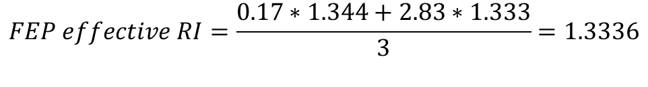
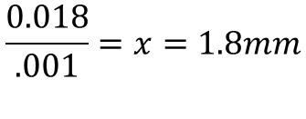
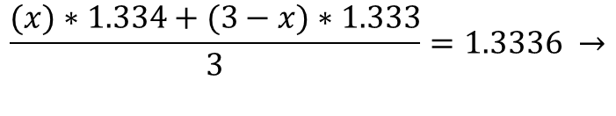
Manufacturing Approaches (possible layer thickness)
Spherical aberration simulations for this are tough to do and time consuming. Rough impact weighted RI calculations may show how much relative impact it would have vs a known like FEP.
Focal length = 3mm
FEP RI = 1.344
Bio-133 RI = 1.334
Water RI = 1.333
$$FEP effective RI=\frac{0.17∗1.344+2.83∗1.333}{3}=1.3336$$
$$thickness of bio133 for same effective RI$$
$$\frac{(x)∗1.334+(3−x)∗1.333}{3}=1.3336 →$$
$$\frac{0.018}{.001}=x=1.8mm$$
According to Calixto from the fluidic core, around 2mm thickness is needed to structurally secure the tubing that goes into the port.
2mm thick bio-133 is hand wavingly projected to have a similar impact as 0.17mm thick FEP in spherical abberations effects
Nikon 16x objective has a 3mm WD. A 2mm thick layer and 0.1mm gap between it and tissue should not interfere with obtaining focus.

Slide 4
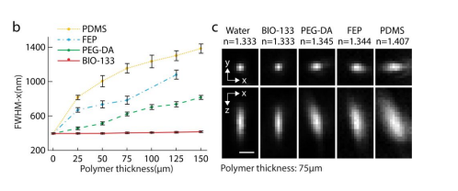
Some diffraction info
A paper, A polymer index-matched to water enables diverse applications in fluorescence microscopy , by Hari Schroff, in lab on chip covered using bio-133 for building a new chamber to hold c elegans for DiSPIM imaging.
We constructed a hybrid 227 multi-material device composed of a PDMS microfluidic base bonded to a BIO-133 upper 228 membrane that sealed in a small PEG-DA disk containing tens of embedded nematodes
We bonded BIO-133 to glass and PDMS with silicone-based adhesive tape

Slide 5
PDMS mold method
Given we have a limited amount of bio-133, I cannot just dump a 2mm thick layer everywhere and spin coat it. The mold is 80mm in diameter. It would take 10mL over that mold to do that. I have 6mL to work with.
1. Blank mold
2. Add thick layer PDMS ( 3-4mm+) and vacuum oven to cure
3. Cut PDMS out around mold to make new effective mold
4. Add bio-133 to make 2mm thick. Place slide on top. Use UV oven to cure
Slide
Needs about 2.75mL per device to make this way. 2 devices per mold
PDMS is hand cut so dumping exact volume may not yield exact thickness desired.
This cannot be spun coat so layer may be slightly uneven. Which could lead to WD issues if severe.
Is the UV oven a vacuum oven? Might get bubbles if not.
Thicker layer may aberrate image more as real RI may differ from documentation. If as reported, should be good.
PDMS must be cut on mold. Creates low, but non-zero chance of breaking mold. Around 500 to make new one.
Current pressure plate is designed for a 2-3mm thick device in all spots to apply pressure around the entire border of device. This matches well to it
7. Remove Bio-133 from PDMS and peel off of slide
6. Remove from mold

